Slide 2
Online Tutorial : Number Two:
Session Three: Logic
Propositions, Symbolic Statements and Truth Tables
Conditional Connectives
Laws of Logic
Logic Gates
Session Four : Functions
What Is a Functions
Functions with Special Properties
Exponential and Logarithmic Functions
Comparing the Size of Functions

Slide 3
Logic: Symbolic Statements and Truth Tables
Propositions
Tautologies and Contradictions
Negation of a proposition
NOT
Compound statements
AND
OR
XOR
Truth Tables

Slide 4
Logic: The Conditional Connectives
The Conditional Connectives
The Conditional Connectives are
If
Only If / Implies (p → q)
If and Only If (p ↔ q)
Truth Tables
The Contra-Positive (approach using truth tables)

Slide 5
Logic: Symbolic Statements and Truth Tables
(2008 Q3a)
Let p and q be the following propositions about an object
p: “ this objects is a triangle”
q: “ this object is blue”
Express each of the following compound propositions symbolically by using p, q and appropriate logic symbols
This object is a blue triangle
If this object is blue, then it is a triangle
This object is not blue, but it is a triangle.

Slide 6
Logic: The Contrapositive
(From previous question,2008 Question 3)
Write in words the contrapositive of the statement given symbolically as “q → p” .
(i.e. If the object is blue then it is a triangle.)
¬p: “ this objects is not a triangle”
¬q: “ this object is not blue”

Slide 7
Logic: The Laws of Logic
The Laws of Logic
The Commutative Laws
The Associative Laws
Distributive Laws
De Morgan’s Laws
Identity Laws
Asborption and Complement Laws

Slide 8
Logic: The Laws of Logic : Membership Tables
p | q | ¬p | ¬q | p∧q (“AND”) | p∨ q (“OR”) | p → q | p ↔ q | p ⊕q (“XOR”)
0 | 0
0 | 1
1 | 0
1 | 1

Slide 9
Logic: The Laws of Logic : Membership Tables
p | q | ¬p | ¬q | p∧q (“AND”) | p∨ q (“OR”) | p → q | p ↔ q | p ⊕q
0 | 0 | 1 | 1 | 0 | 0 | 1 | 1 | 0
0 | 1 | 1 | 0 | 0 | 1 | 1 | 0 | 1
1 | 0 | 0 | 1 | 0 | 1 | 0 | 0 | 1
1 | 1 | 0 | 0 | 1 | 1 | 1 | 1 | 0

Slide 10
Logic: The Laws of Logic
(2012 Zone B Question 2 c) Use Truth Tables to prove that:
(p∧q) ∨ (¬p ∧ ¬q) ≡ p ↔ q
p | q | p∧q | ¬p | ¬q | (¬p ∧ ¬q) | (p∧q) ∨ (¬p ∧ ¬q) | p ↔ q
0 | 0 |  | 1 | 1 |  |  | 1
0 | 1 |  | 1 | 0 |  |  | 0
1 | 0 |  | 0 | 1 |  |  | 0
1 | 1 |  | 0 | 0 |  |  | 1

Slide 11
Logic: The Laws of Logic (Answer)
(2012 Zone B Question 2 c) Use Truth Tables to prove that:
(p∧q) ∨ (¬p ∧ ¬q) ≡ p ↔ q
p | q | p∧q | ¬p | ¬q | (¬p ∧ ¬q) | (p∧q) ∨ (¬p ∧ ¬q) | p ↔ q
0 | 0 | 0 | 1 | 1 | 1 | 1 | 1
0 | 1 | 0 | 1 | 0 | 0 | 0 | 0
1 | 0 | 0 | 0 | 1 | 0 | 0 | 0
1 | 1 | 1 | 0 | 0 | 0 | 1 | 1

Slide 12
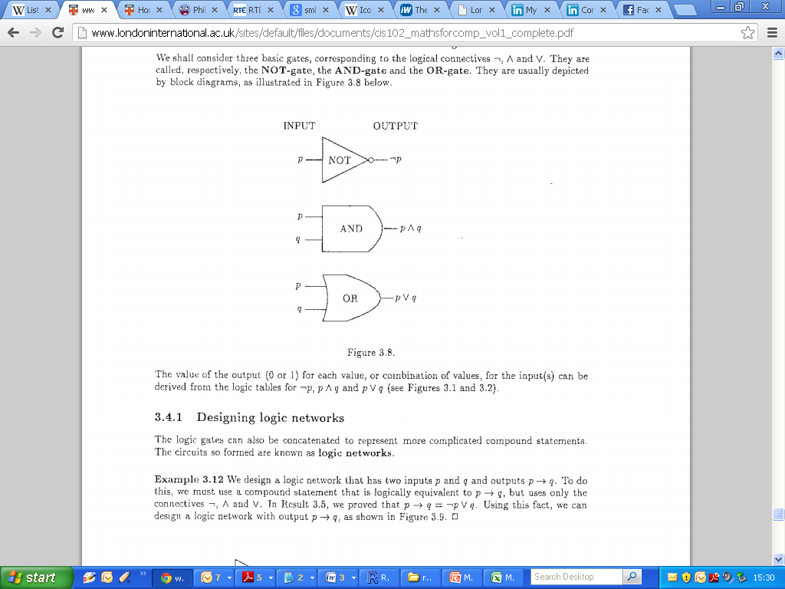
Logic: Logic Gates
Designing Logic Gates
Output of a given Network

Slide 13
Logic: Logic Gates
(2008 Q3b)
Construct a logic network that accepts as inputs p and q, which may independently have value 0 or 1, and give as final output ¬(p ∧ ¬q) .
Show that this expression is equivalent to p → q. (i.e. using truth tables)

Slide 14
Logic: Logic Gates

Slide 15
Functions: What is a Function
Functions
Introduction and Definitions
Arrow Diagram of a Function
Boolean Functions and ordered n-tuples
Absolute Value Functions
Floor and Ceiling Functions
Polynomial Functions
Equality of Functions

Slide 16
Functions: Functions with Special Properties
Functions
Encoding and Decoding Function
Onto Functions
One-to-One Functions
Inverse Functions
One to One Correspondence

Slide 17
Functions: What is a Function
Arrow Diagrams (2010 Zone B Q4 a)
A function f: X->Y, where X = {p,q,r,s} and Y={1,2,3,4,5} is given by the subset of X x Y. {(q,3),(r,3),(p,5),(s,2)}
i. Show f as an arrow diagram

Slide 18
Functions: What is a Function
Arrow Diagrams (2010 Zone B Q4 a)
A function f: X->Y, where X = {p,q,r,s} and Y={1,2,3,4,5} is given by the subset of X x Y. {(q,3),(r,3),(p,5),(s,2)}
ii. State the domain, co-domain and range of f.
The domain of this function is {p,q,r,s},
The co-domain is {1,2,3,4,5}
The range is {2,3,5}.

Slide 19
Functions: One to One
Arrow Diagrams

Slide 20
Functions: Onto
Arrow Diagrams

Slide 21
Functions: One to One and Onto
Arrow Diagrams

Slide 22
Functions: What is a Function
Arrow Diagrams (2010 Zone B Q4 a)
A function f: X->Y, where X = {p,q,r,s} and Y={1,2,3,4,5} is given by the subset of X x Y. {(q,3),(r,3),(p,5),(s,2)}
iii. Say why f does not have the one-to-one property and why f does not have the onto property, giving a counter example in each case.
-The function is not one-to-one because 3 in the co-domain has more than one ancestor, i.e p and q.
-The function is not onto because 1 and 4 in the co-domain have no ancestors.

Slide 23
Functions: Functions with Special Properties
Inverse of Functions (2010 Zone B Question 4 part b).
1. State the condition to be satisfied in order for an function to have an inverse.
(N.B. Very formal definition required – see Definition 4.14 page 56)

Slide 24
Functions: Inverse Functions

Slide 25
Functions: Inverse Functions

Slide 26
Functions: Floor and Ceiling Functions
Study Guide Page 67 Q5: Find the floor and ceiling of the following numbers.
Number | Workings | Floor | Ceiling
-1.4
2.3
7/9
-16/3
0
1

Slide 27
Functions: Exponential and Logarithmic Functions
Exponential and Logarithmic Functions
Exponential Functions
Laws of Exponents (Section 4.3.1)
Logarithmic Functions (section 4.3.2)
Base of Logarithms and the Natural Logarithm
Laws of Logarithms (Rules 4.23)
Change of Base ( Rule 4.24)

Slide 28
Functions: Exponential and Logarithmic Functions
Exponential and Logarithmic Functions
Laws of Exponents (Section 4.3.1)

Slide 29
Functions: Exponential and Logarithmic Functions
Exponential and Logarithmic Functions
Laws of Logarithms (Rules 4.23)

Slide 30
Functions: Exponential and Logarithmic Functions
(Page 67 Q 10) Without using your calculator, find the value of the following numbers.
Number | Workings 1 | Workings 2 | Answers
Log 2128
Log2(4√2)
Log2(1/8)
Log2(√2/16)

Slide 31
Functions: Exponential and Logarithmic Functions
(Blank Page)

Slide 32
Functions: Exponential and Logarithmic Functions
(Blank Page)

Slide 33
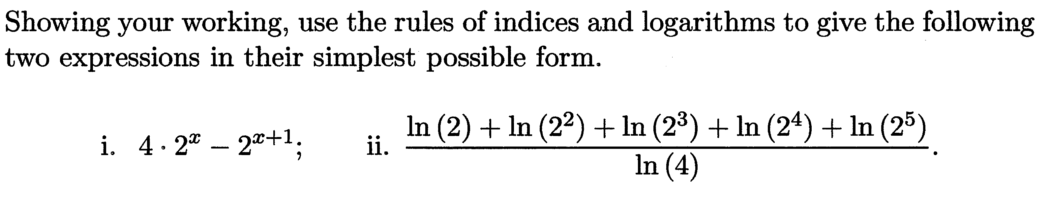
Functions: Exponential and Logarithmic Functions (2012 – Question 4a)

Slide 34
Functions: Exponential and Logarithmic Functions

Slide 35
Functions: Inverse Functions

Slide 36
Functions: Inverse Functions

Slide 37
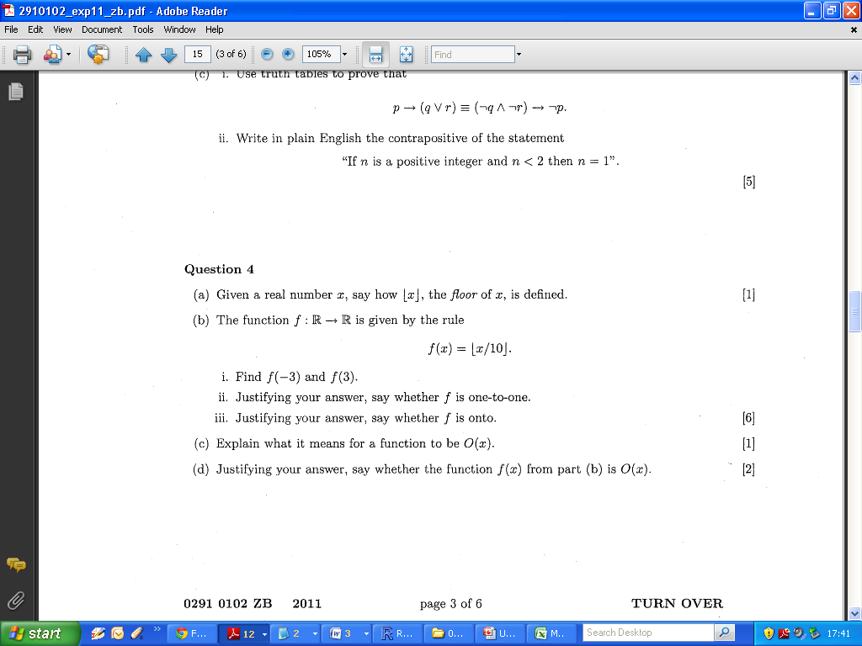
Functions: Inverse Functions
- 2011 Zone B Q4 b

Slide 38
Functions: Inverse Functions
- 2011 Zone B Q4 b

Slide 39
Functions: Comparing Functions
Comparing Functions
O-notation
Power Functions
Orders of Polynomial Functions
Comparison of Algorithms

